Slide 1

E6893 Big Data Analytics:
Geographic and Financial Impact of Carbon Tax in the United States
Team Members: Keir Lauritzen (kcl2143)
Adam Owens (ao2595)
Kosta Andoni (ka2604)
November 17, 2016
1

Slide 2
Motivation
Carbon taxes have been proposed to address climate change
Financial cost of carbon tax will vary geographically
Commuters who travel long distances for work in cities will have higher costs
Impact will vary geographically
Generally, incomes vary as you move away from city centers (not NYC or SF)
Cost relative to income may fall disproportionately on certain areas.
City: $$$/$
Suburbs: $$
Exurbs: $
Income distribution
Understanding distribution of costs helps illuminate likelihood of any potential implementation (in future)
2

Slide 3
Expected Contributions and Timeline
Build data set Dec 2
Build all models and analysis tools by Dec 9
Prepare report and presentation Dec 15
Adam Owens will focus on analysis and algorithm
Keir Lauritzen will focus on building the data set
Kosta Andoni will focus on analysis and algorithm
Each team member will assist the other.
3

Slide 4
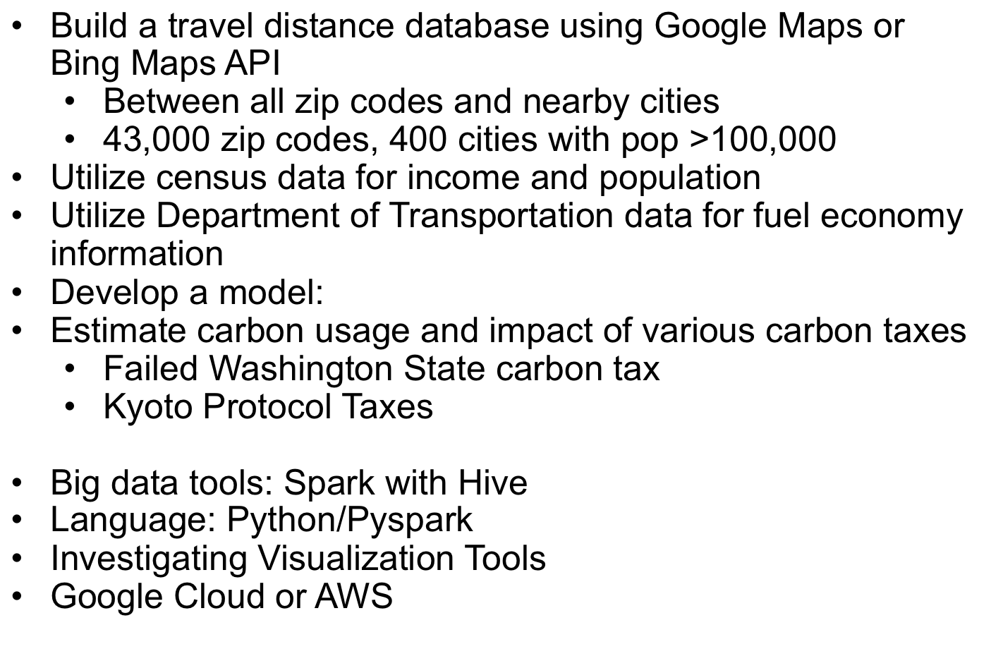
Dataset, Algorithm, and Tools
Build a travel distance database using Google Maps or Bing Maps API
Between all zip codes and nearby cities
43,000 zip codes, 400 cities with pop >100,000
Utilize census data for income and population
Utilize Department of Transportation data for fuel economy information
Develop a model: $commuters\left(distance, population\right)$
Estimate carbon usage and impact of various carbon taxes
Failed Washington State carbon tax
Kyoto Protocol Taxes
Big data tools: Spark with Hive
Language: Python/Pyspark
Investigating Visualization Tools
Google Cloud or AWS
4

